Slide 1
WebGL & Three.js
Jesse Brand
4/10/2016
Chapter Full Stack 5 → 1

Slide 2
Agenda
08:30 Introduction & Background
What is WebGL?
WebGL & general 3d graphics concepts (1)
Hands-on with three.js (1)
09:30 Assignment
10:00 WebGL & general 3d graphics concepts (1)
Hands-on with three.js (1)
10:30 Assignment
11:15 Demos
11:45 Room for additional questions
12:00 End

Slide 3
Purpose of Chapter Meetings
Kennis opdoen van WebGL en Three.JS
Uitzoeken wat ervoor nodig is om Three.JS te kunnen gebruiken binnen ING
Proberen business / UX te prikkelen met wat we met deze techniek kunnen

Slide 4
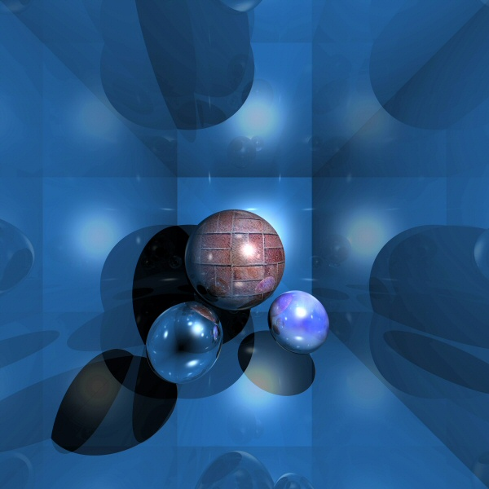
What is WebGL?

Slide 5
WebGL
What is it and what is it not?
Wikipedia: WebGL (Web Graphics Library) is a JavaScript API for rendering interactive 3D computer graphics and 2D graphics within any compatible web browser without the use of plug-ins. WebGL is integrated completely into all the web standards of the browser allowing GPU accelerated usage of physics and image processing and effects as part of the web page canvas.
WebGL 1.0 is based on OpenGL ES 2.0 (for Embedded Systems) and provides an API for 3D graphics.

Slide 6
WebGL vs OpenGL
Wikipedia: OpenGL is a cross-language, cross-platform application programming interface (API) for rendering 2D and 3Dvector graphics. The API is typically used to interact with a graphics processing unit (GPU), to achieve hardware-accelerated rendering.

Slide 7
Examples
Examples
http://threejs.org/examples/#webgl_loader_collada_keyframe
http://threejs.org/examples/#webgl_animation_cloth
http://threejs.org/examples/#webgl_postprocessing_dof2
http://threejs.org/examples/#webgl_materials_video
http://threejs.org/examples/#webgl_materials_cubemap_balls_reflection
Real-life examples
http://eyes.nasa.gov/curiosity/
https://secured-static.greenpeace.org/russia/...

Slide 8
WebGL and general 3d graphics Concepts (1)

Slide 9
Onderdelen van een scene
Wat is een scene?
De verzameling van alle objecten in de huidige bestaande 3d wereld.
Soorten objecten:
Camera’s
Meshes
Lichten

Slide 10
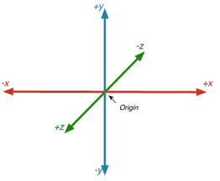
Coordinate System

Slide 11
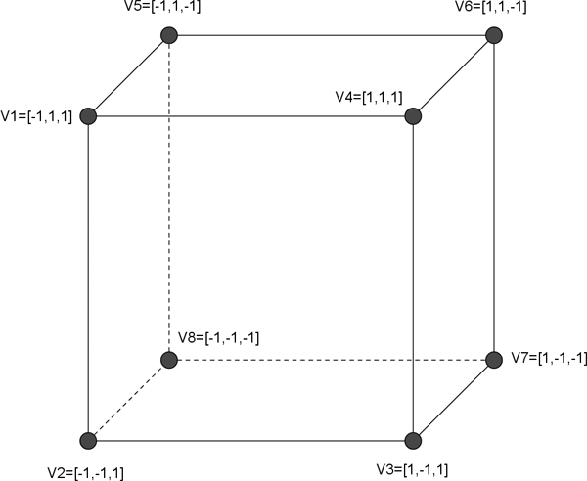
Vertices (Singular: Vertex)

Slide 12
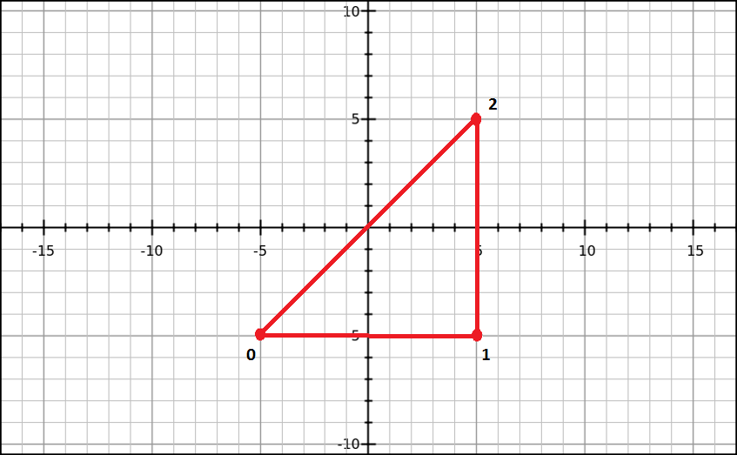
Triangles (tris)

Slide 13
Getting Started with WebGL
<body onload=“initWebGL();">
<canvas id=“wgl" width="500" height="500"></canvas>
</body>
var gl;
var program;
function initWebGL() {
var canvas = document.getElementById("wgl");
gl = initGL(canvas);
gl.viewport(0, 0, canvas.width, canvas.height);
program = initShaders();
drawScene();
}
function initGL(canvas) {
return canvas.getContext("webgl")
|| canvas.getContext("experimental-webgl");
}

Slide 14
Getting Started with WebGL
R,G,B (0.0-1.0)
Alpha (0.0-1.0)
Creëer een buffer Initialiseer hem met de data Maak hem “actueel” in WebGL
function drawScene() {
gl.clearColor(0.0, 0.0, 0.0, 1.0);
gl.clear(gl.COLOR_BUFFER_BIT);
var vertices = new Float32Array([-1.0, -1.0, 1.0, -1.0, -1.0, 1.0]);
var buffer = gl.createBuffer();
gl.bindBuffer(gl.ARRAY_BUFFER, buffer);
gl.bufferData(gl.ARRAY_BUFFER, vertices, gl.STATIC_DRAW);
var colorLocation = gl.getUniformLocation(program, "uColor");
gl.uniform4fv(colorLocation, [0.0, 1.0, 0.0, 1.0]);
var positionLocation = gl.getAttribLocation(program, "aPosition");
gl.enableVertexAttribArray(positionLocation);
gl.vertexAttribPointer(positionLocation, 2, gl.FLOAT, false, 0, 0);
gl.drawArrays(gl.TRIANGLES, 0, 3);
}
Achtergrondkleur
Pas achtergrond toe
3 Vertices
Stel kleur in
Transformeer coordinaten naar view huidige camera
Attributen in shaders (out of scope)
Teken de inhoud van de huidige buffer als triangles in de view.
Aantal vertices
Vertices hebben 2 componenten.
Je stopt er float waarden in.
Vertel WebGL dat je vertices wil gaan tekenen.

Slide 15
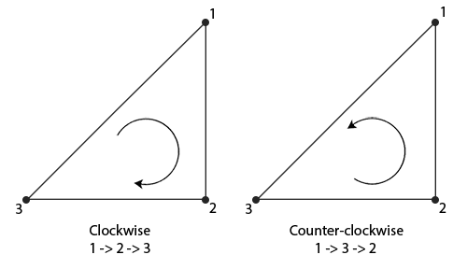
Vertex order

Slide 16
Vertices vs Vectors
(x, y, z)
Vertex | Vector
Coordinaat Positie | Richting Evt afstand Kan genormaliseerd worden Bijv: Normal

Slide 17
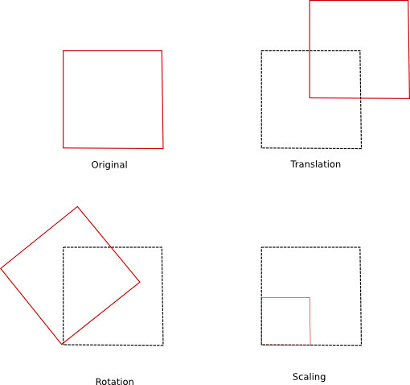
Transformations

Slide 18
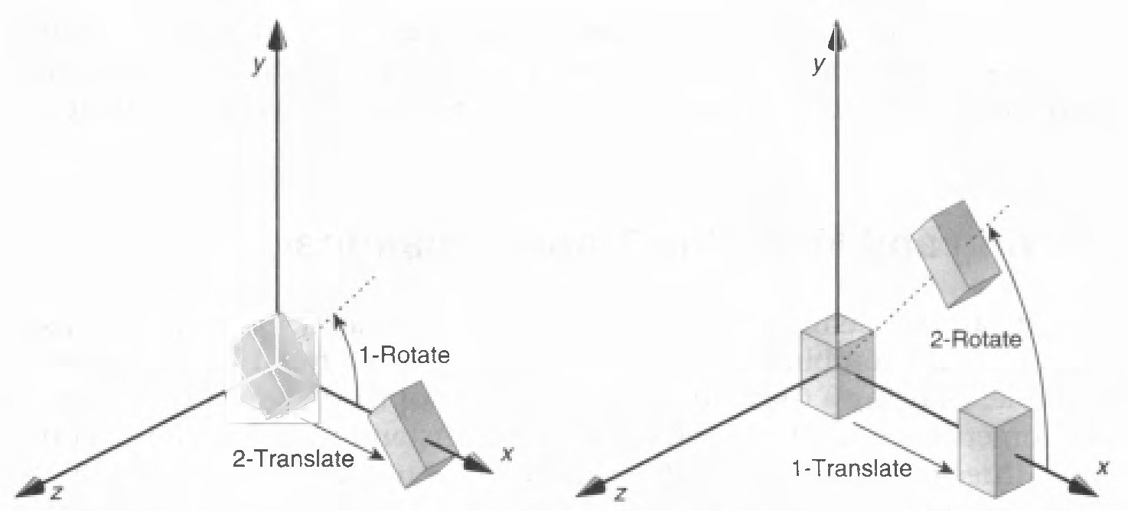
Transformations
Order is very important!

Slide 19
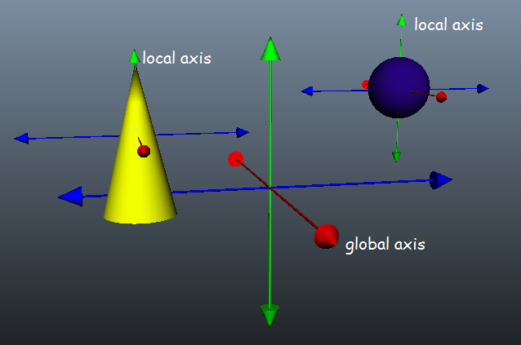
Global vs local coordinates

Slide 20
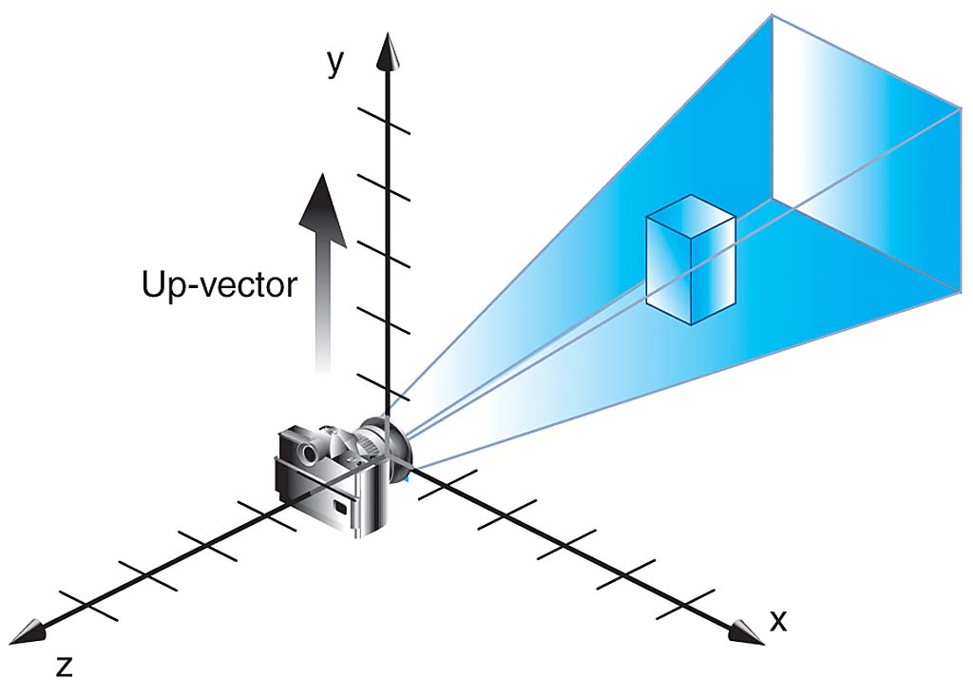
Cameras

Slide 21
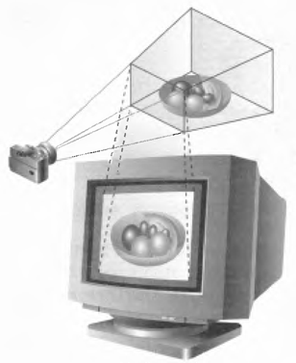
Viewport & Frustum
Frustum
Camera
Viewport

Slide 22
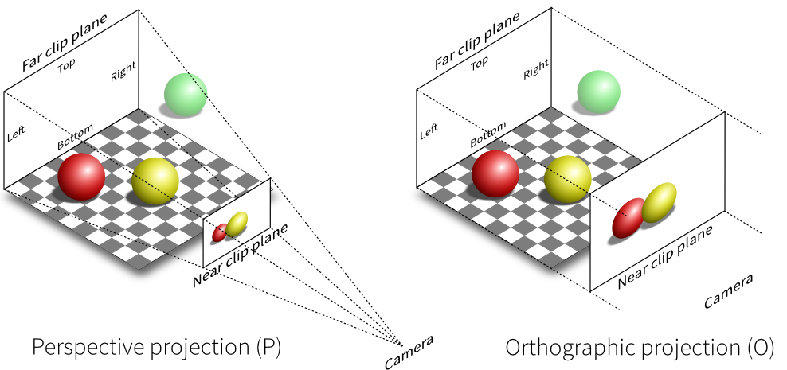
Camera Projections

Slide 23
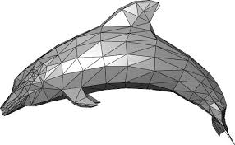
Meshes, Triangles (Tris), Edges
Mesh
Triangle
Edge

Slide 24
Hands-on with three.js (1)

Slide 25
Three JS
What is three js..
Examples
http://threejs.org/examples/#webgl_loader_collada_keyframe
http://threejs.org/examples/#webgl_animation_cloth
http://threejs.org/examples/#webgl_postprocessing_dof2
http://threejs.org/examples/#webgl_materials_video
http://threejs.org/examples/#webgl_materials_cubemap_balls_reflection

Slide 26
Scene en renderer
var width = window.innerWidth;
var height = window.innerHeight;
var scene = new THREE.Scene();
var camera = new THREE.PerspectiveCamera( 75, width/height, 1, 1000 );
// create renderer and add to DOM
var renderer = new THREE.WebGLRenderer();
renderer.setSize( width, height );
document.body.appendChild( renderer.domElement );
// animation loop
function render() {
requestAnimationFrame( render );
renderer.render( scene, camera );
}
render();
PerspectiveCamera( fov, aspect, near, far )

Slide 27
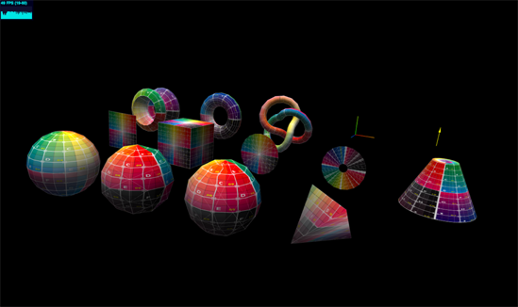
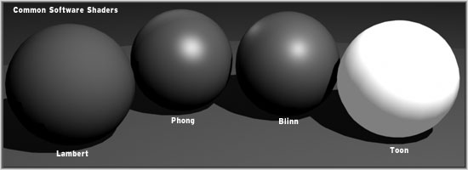
Creating an object
Geometries
BoxBufferGeometry
BoxGeometry
CircleBufferGeometry
CircleGeometry
CylinderBufferGeometry
CylinderGeometry
ConeBufferGeometry
ConeGeometry
DodecahedronGeometry
ExtrudeGeometry
IcosahedronGeometry
LatheBufferGeometry
LatheGeometry
OctahedronGeometry
ParametricGeometry
PlaneBufferGeometry
PlaneGeometry
PolyhedronGeometry
RingBufferGeometry
RingGeometry
ShapeGeometry
SphereBufferGeometry
SphereGeometry
TetrahedronGeometry
TextGeometry
TorusBufferGeometry
TorusGeometry
TorusKnotBufferGeometry
TorusKnotGeometry
TubeGeometry
Materials
LineBasicMaterial
LineDashedMaterial
Material
MeshBasicMaterial
MeshDepthMaterial
MultiMaterial
MeshLambertMaterial
MeshNormalMaterial
MeshPhongMaterial
MeshStandardMaterial
PointsMaterial
RawShaderMaterial
ShaderMaterial
SpriteMaterial
Material
Geometry
Mesh
Add to scene
Change position of the cube relative to the camera
var material = new THREE.MeshBasicMaterial( { color: 0x00ff00 } );
var geometry = new THREE.BoxGeometry( 2, 2, 2 );
var cube = new THREE.Mesh( geometry, material );
scene.add( cube );
cube.position.z = -10;

Slide 28
Rotating and moving the object
Rotating the object
cube.rotation.x = 0.3;
cube.rotation.y = 0.3;
Continuous rotation
function render() {
requestAnimationFrame( render );
cube.rotation.x += 0.01;
cube.rotation.y += 0.01;
renderer.render( scene, camera );
}

Slide 29
Assignment: Make a moving vehicle
Create a scene and a renderer
Make the needed objects for the vehicle. For example a few cubes for the body and cylinders for the wheels
Let the vehicle ride

Slide 30
WebGL and general 3d graphics Concepts (2)

Slide 31
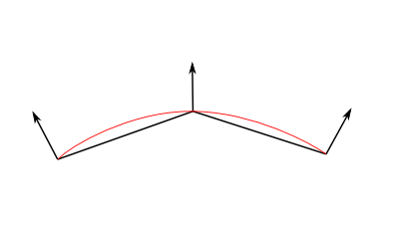
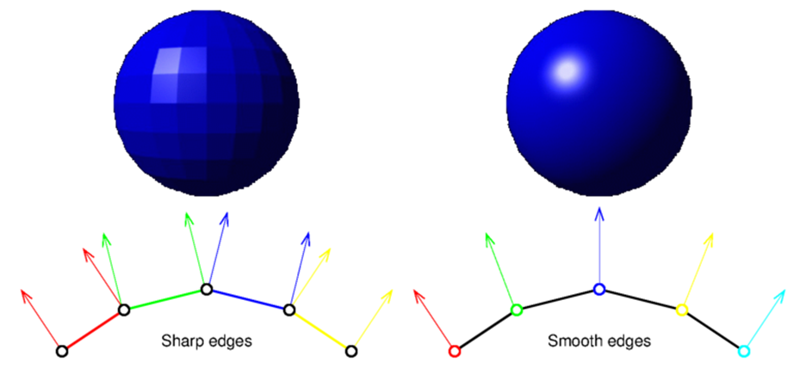
Normals

Slide 32
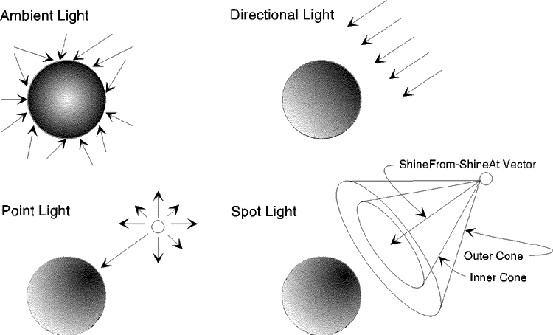
Lights

Slide 33
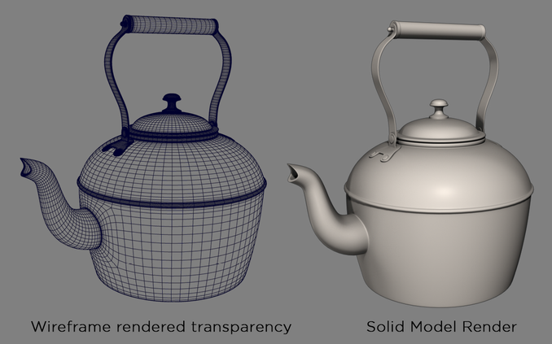
Rendering Modes

Slide 34
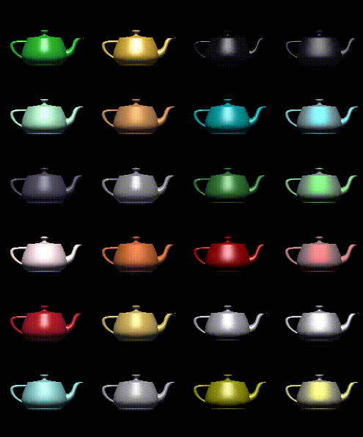
Materials

Slide 35
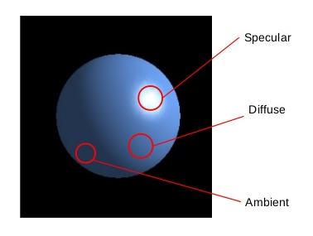
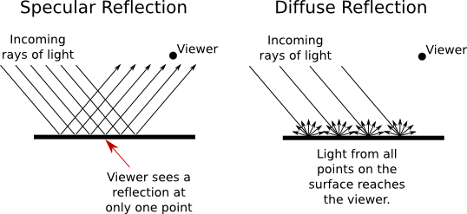
Shaders - Lighting Types

Slide 36
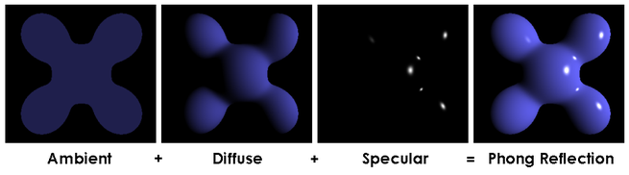
Shaders - Phong

Slide 37
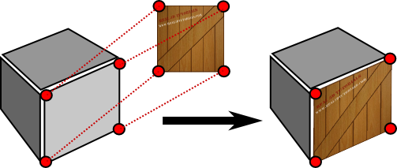
Textures

Slide 38
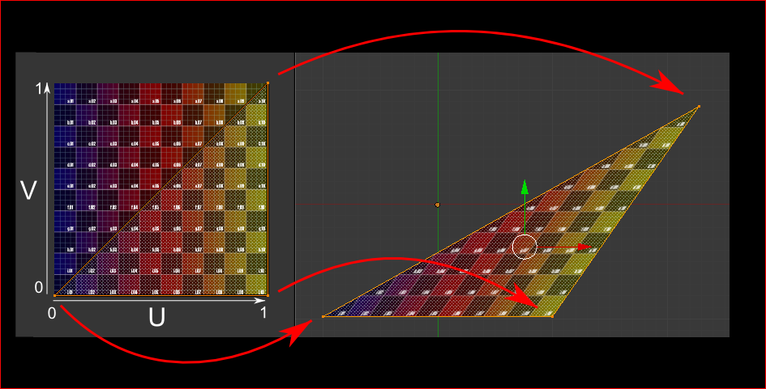
U/V Coordinates

Slide 39
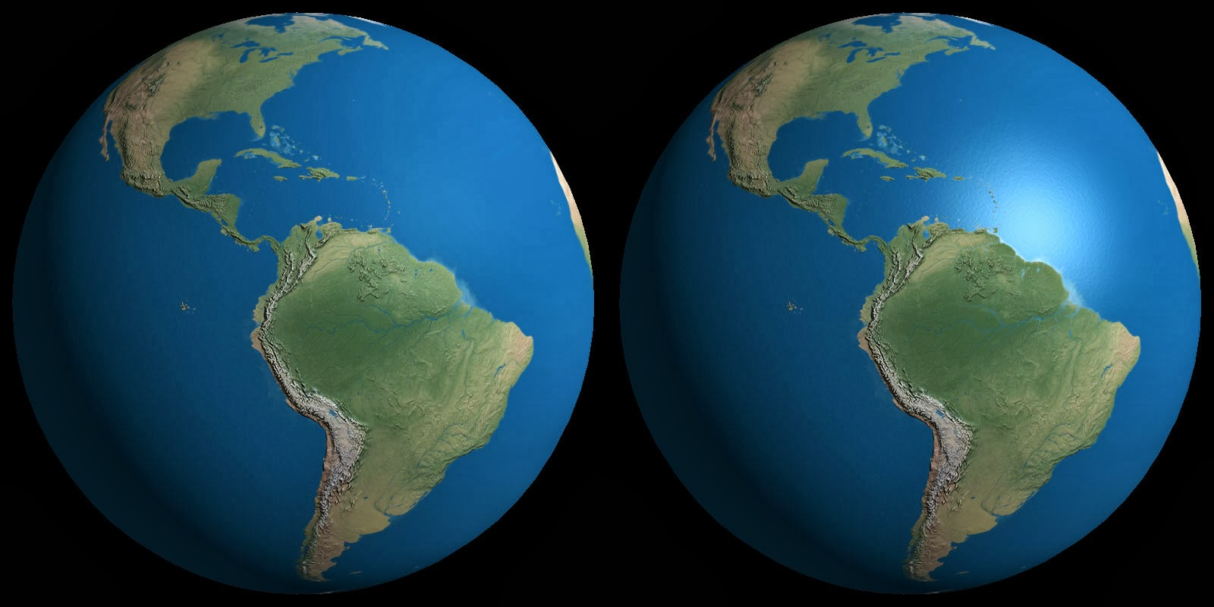
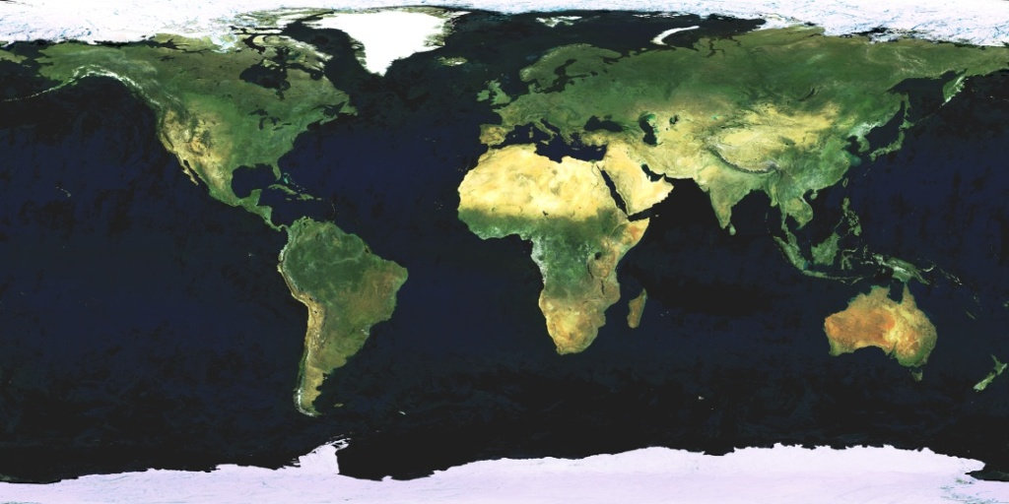
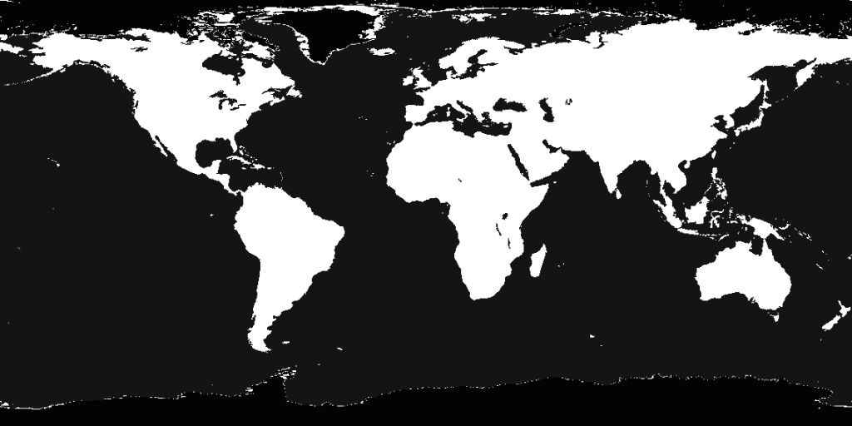
Specular Maps

Slide 40
Hands-on with three.js (2)

Slide 41
Adding textures
var texture = new THREE.TextureLoader().load( ['ez.jpg'] );
var material = new THREE.MeshBasicMaterial( { map: texture } );
var geometry = new THREE.BoxGeometry( 2, 2, 2 );
var cube = new THREE.Mesh( geometry, material );

Slide 42
Lighting: ambient light
Ambient light
var ambient = new THREE.AmbientLight( 0xffffff, 0.1 );
scene.add( ambient );
Use correct material
No lights and shadows on
THREE.MeshBasicMaterial( { map: texture } );
Materials that absorb/reflect lights and shadows
THREE.MeshPhongMaterial( { map: texture } );
THREE.MeshLambertMaterial( { map: texture } );
THREE.MeshStandardMaterial ( { map: texture } );

Slide 43
Lighting: spotlight
renderer.shadowMap.enabled = true;
renderer.gammaOutput = true;
spotLight = new THREE.SpotLight( 0xffffff );
spotLight.position.set( 10, 18, -10 );
spotLight.angle = Math.PI / 8;
spotLight.castShadow = true;
spotLight.shadow.mapSize.width = 1024;
spotLight.shadow.mapSize.height = 1024;
scene.add( spotLight );
spotLight.decay = 2;
spotLight.penumbra = 0.5;
spotLight.shadow.camera.near = 1;
spotLight.shadow.camera.far = 4000;
cube.receiveShadow = true;
cube.castShadow = true;

Slide 44
Moving the camera
function render() {
requestAnimationFrame( render );
cube.rotation.x += 0.01;
cube.rotation.y += 0.01;
camera.position.z -= 0.01;
camera.position.x -= 0.02;
renderer.render( scene, camera );
}

Slide 45
Assignment: Make a moving vehicle (continued)
Create a scene and a renderer
Make the needed objects for the vehicle. For example a few cubes for the body and cylinders for the wheels
Let the vehicle ride
Add some textures to the vehicle
Let the wheels spin
Add some lights
Go wild, add some more cameras, objects lights in the vehicle, and everything you ever dreamed of

Slide 46
Libraries en frameworks
Frameworks
Three.js - http://threejs.org/
Blend4web - https://www.blend4web.com/en/
Copperlicht - http://www.ambiera.com/copperlicht/
Clara.io - https://clara.io/
Unity – https://unity3d.com/
…and more - https://en.wikipedia.org/wiki/List_of_WebGL_frameworks
Libraries
gl-matrix - https://github.com/toji/gl-matrix
Uiteenlopend van simpele libraries naar js frameworks naar full-fledged editor suites

Slide 47
Resources & Tutorials
http://threejs.org/docs/index.html
http://learningwebgl.com/blog/?page_id=1217
http://webglfundamentals.org/
https://developer.mozilla.org/en-US/docs/Web/API/WebGL_API/Tutorial
http://www.html5rocks.com/en/tutorials/webgl/webgl_fundamentals/
http://www.creativebloq.com/javascript/get-started-webgl-draw-square-7112981

Slide 48
Thank you

